Slide 1
Cryptography Concepts Past and Present
Georges Kesseler

Slide 2
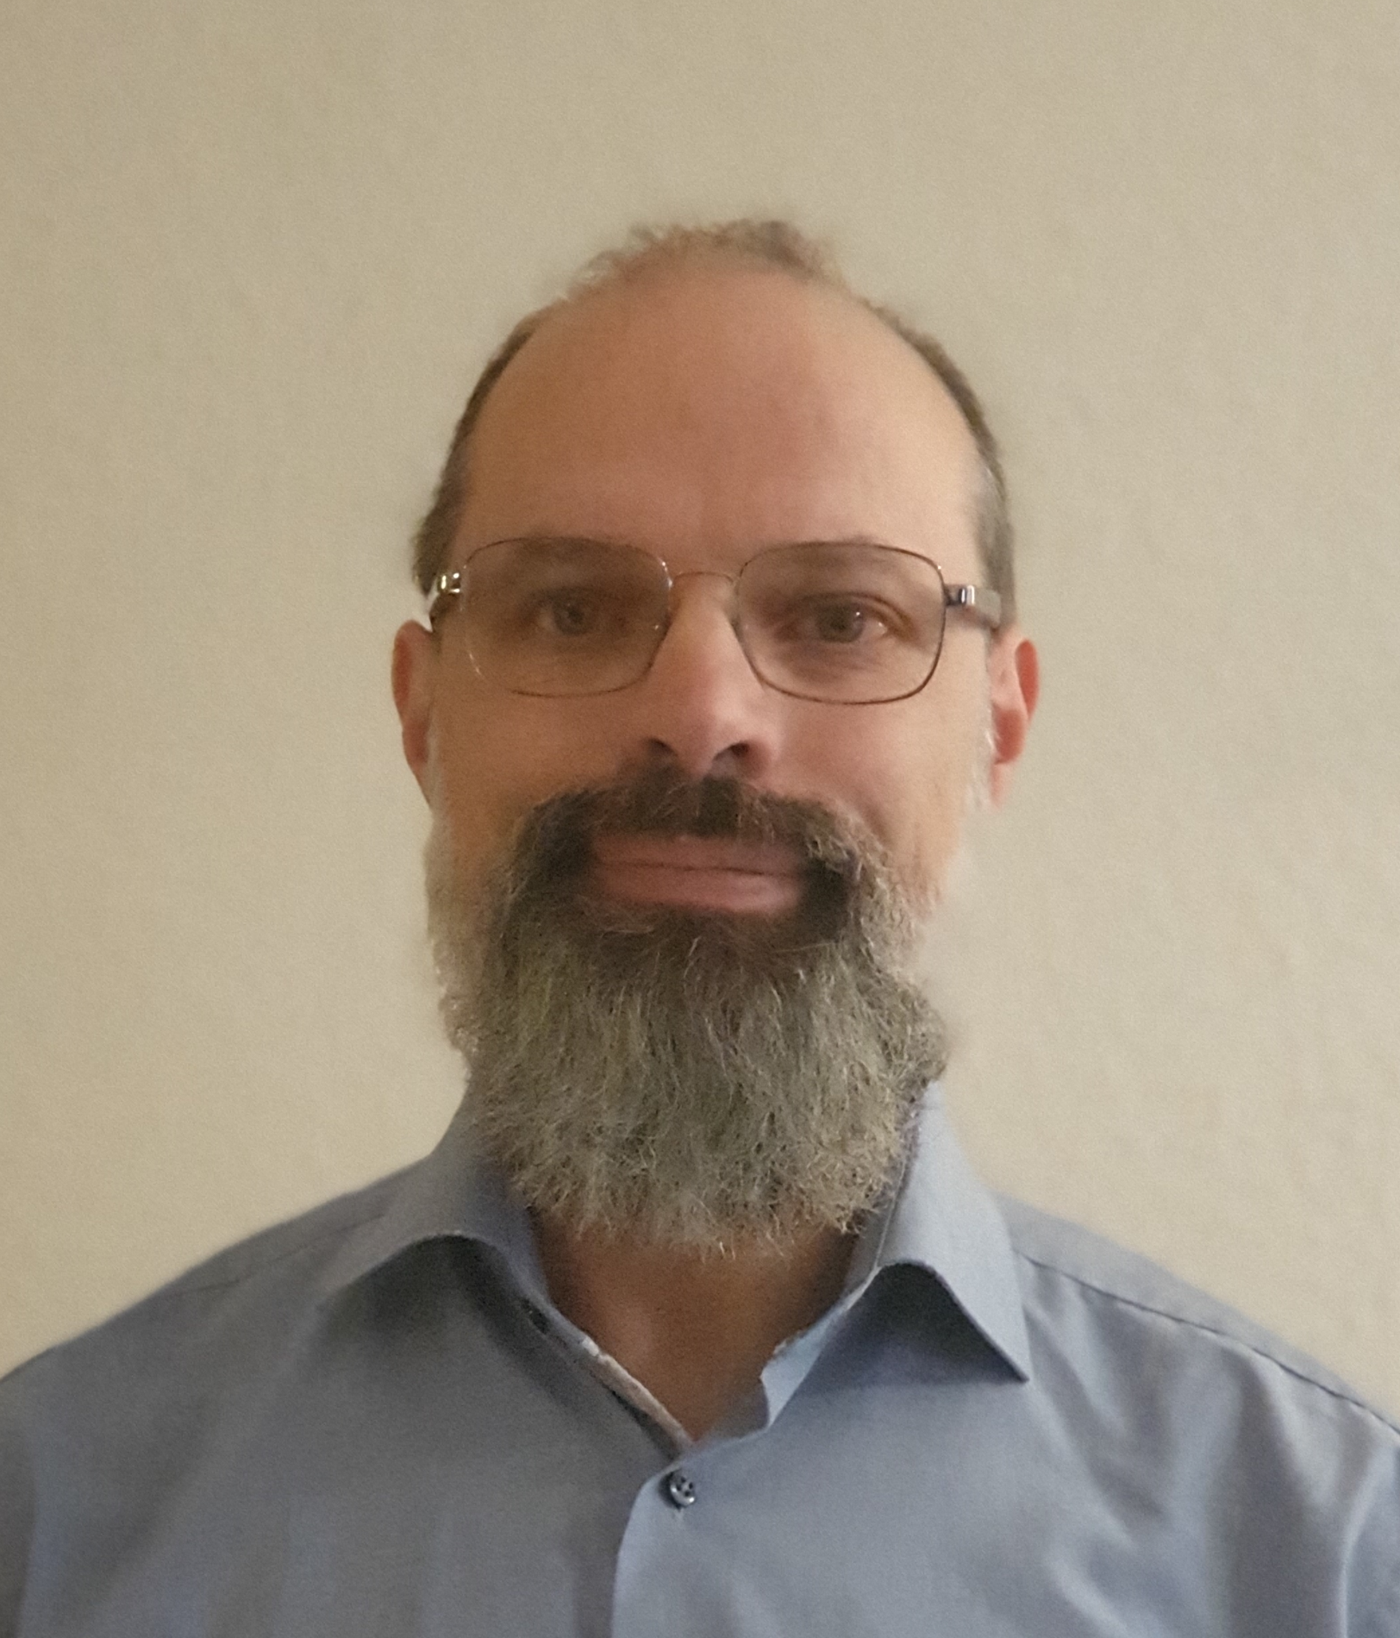
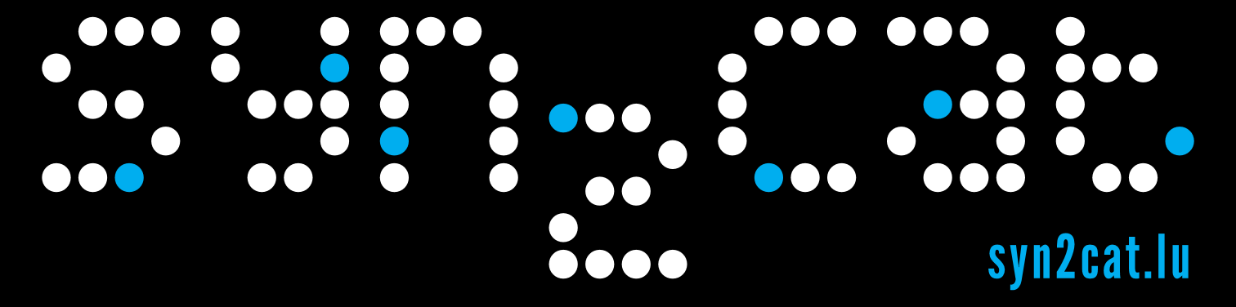

About Me
Georges Kesseler
30 years in IT
Sysadmin
Security officer
2022: Coach at DLH
2023: Sysadmin at DLH
Syn2cat asbl
Level2 hackerspace https://level2.lu/

Slide 3
Part1
History of Cryptography

Slide 4
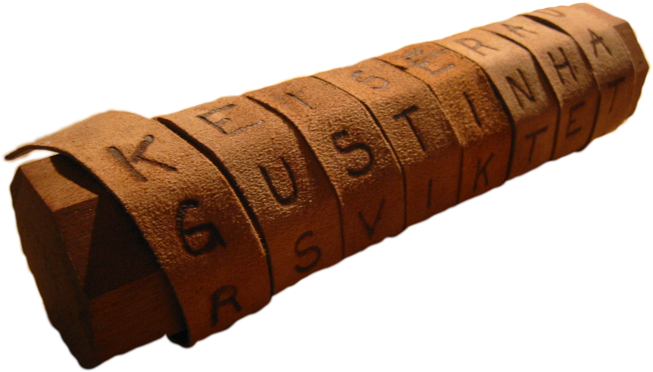
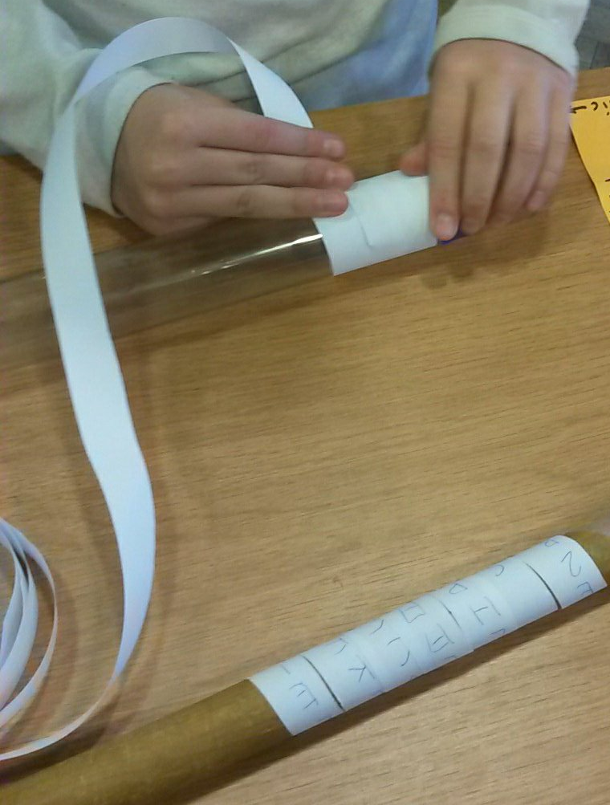
History of Cryptography
Scytale (Greece)
Cleartext
Plaintext
Cyphertext
Encrypted data
Password
Key
Algorithm
Padding
CC BY-SA 3.0, https://commons.wikimedia.org/w/index.php?curid=1698345

Slide 5

History of Cryptography
Pigpen
Freemasons

Slide 6


History of Cryptography
Plaintext
The original document
Cyphertext
The encrypted data
Substitution
cypher
Security by
obscurity

Slide 7
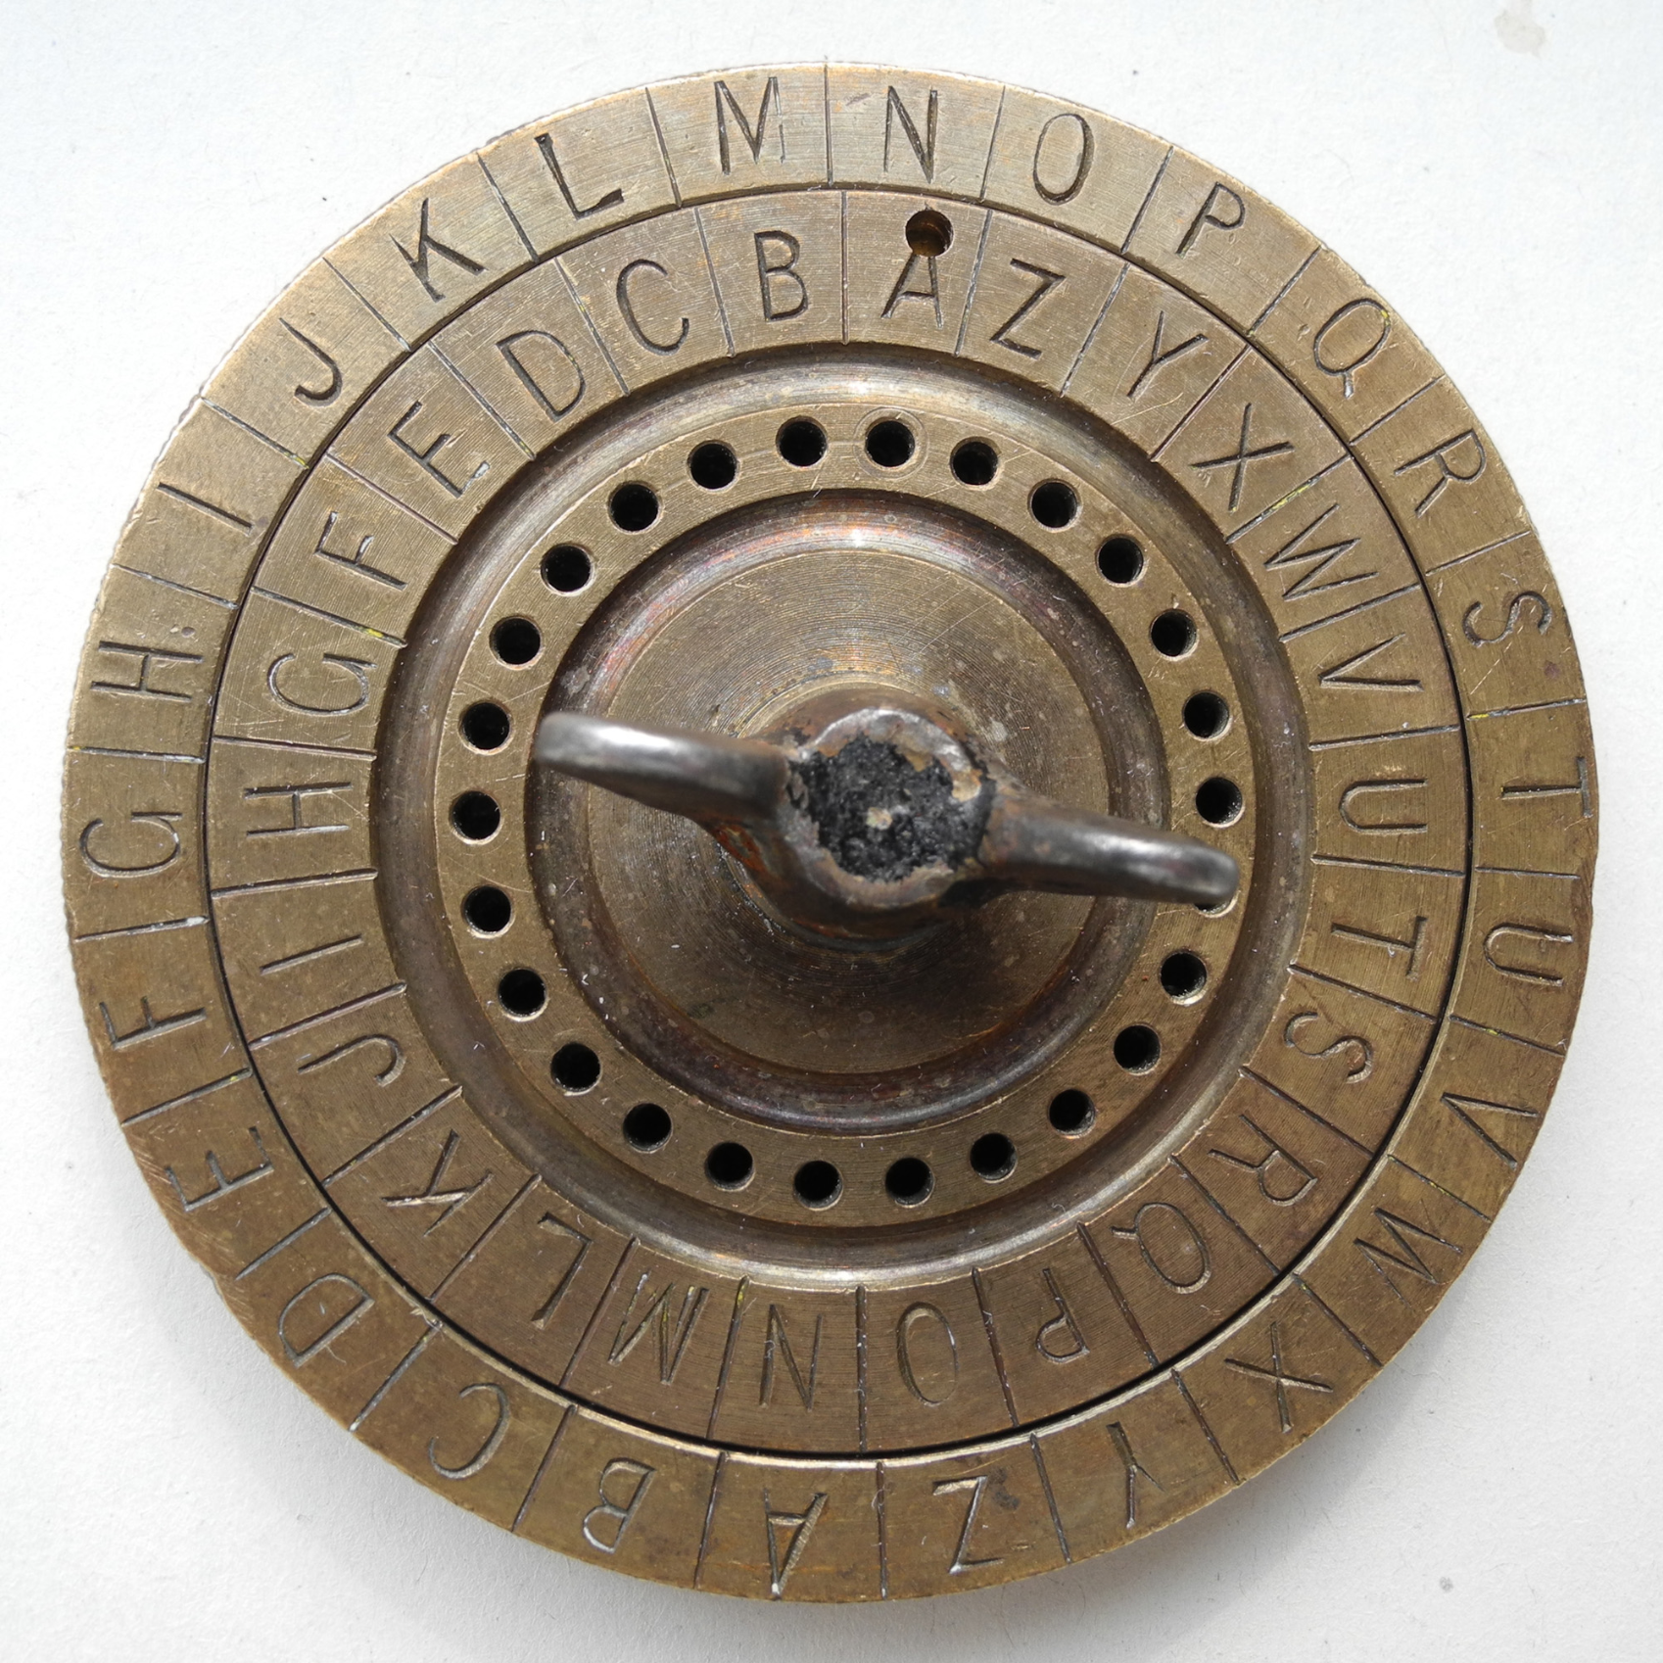
History of Cryptography
Caesar Cypher
Roman Empire

Slide 8
History of Cryptography
Caesar Cypher
Encrypt and decrypt
Plain | A | B | C | D | E | F | G | H | I | J | K | L | M | N | O | P | Q | R | S | T | U | V | W | X | Y | Z
Cipher | X | Y | Z | A | B | C | D | E | F | G | H | I | J | K | L | M | N | O | P | Q | R | S | T | U | V | W
Plaintext: THE QUICK BROWN FOX JUMPS OVER THE LAZY DOG
Ciphertext: QEB NRFZH YOLTK CLU GRJMP LSBO QEB IXWV ALD
Decrypted: THE QUICK BROWN FOX JUMPS OVER THE LAZY DOG

Slide 9
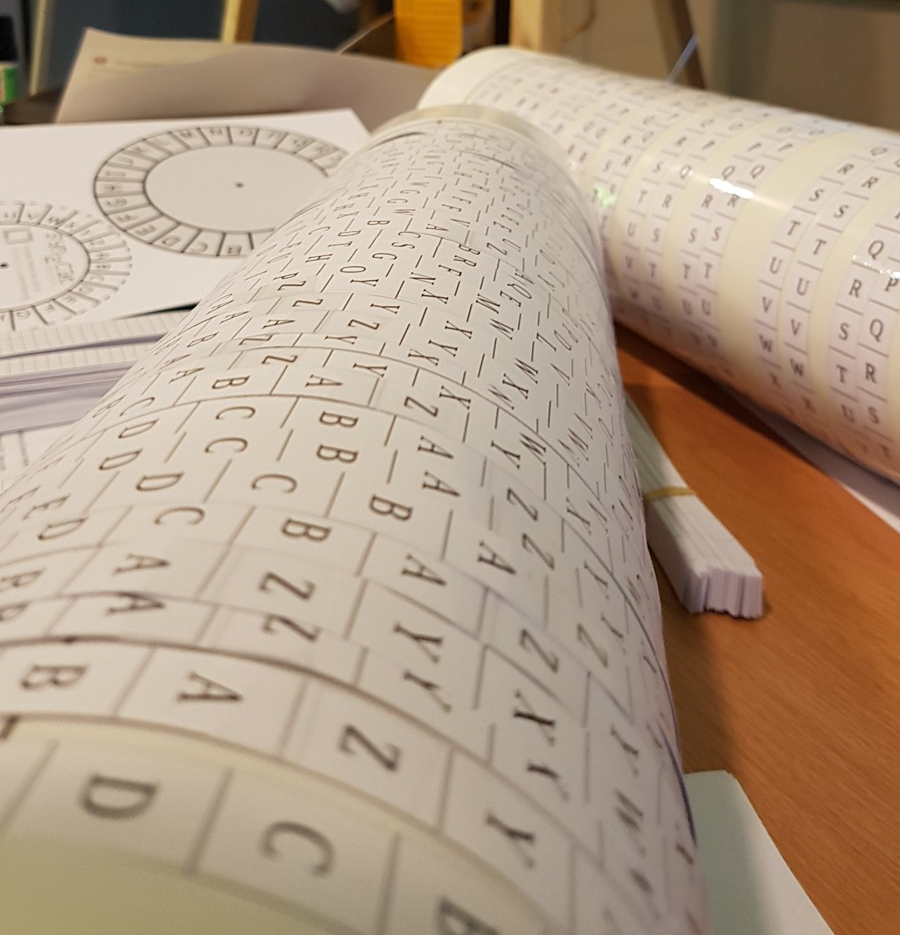
History of Cryptography
Caesar Cypher
Brute force attack
Dictionary
attack
Bruteforce
attack
Drumputer emulator
Q | B | W | P | A | L | Y
R | C | X | Q | B | M | Z
S | D | Y | R | C | N | A
T | E | Z | S | D | O | B
U | F | A | T | E | P | C
V | G | B | U | F | Q | D
W | H | C | V | G | R | E
...

Slide 10
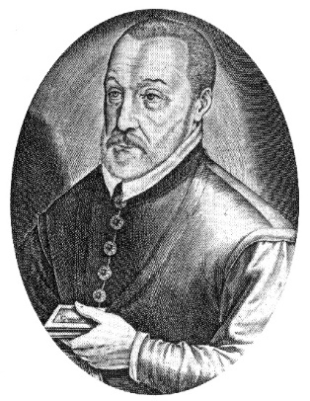
History of Cryptography
Vigenère
Renaissance
16th century

Slide 11
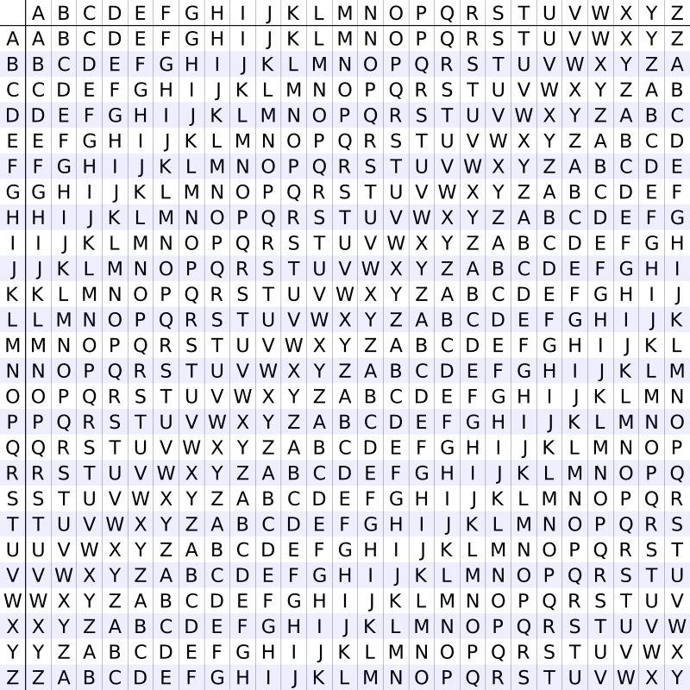
Plaintext
Plaintext: digitallearninghub
Key: LEMONLEMONLEMONLEM
Ciphertext: OMSWGLPXSNCRUBTSYN
Cyphertext
https://www.usna.edu/Users/cs/wcbrown/courses/si110AY13S/resources/vigenere/VigenereCipher.html
Keyword
https://commons.wikimedia.org/w/index.php?curid=15037524

Slide 12

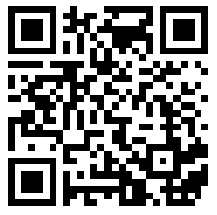
Decrypting:
https://www.youtube.com/watch?v=rccRQcyKB5g

Slide 13
History of Cryptography
Vigenère
Weakness
Key: ABCDABCDABCDABCDABCDABCDABCD Plaintext: cryptoisshortforcryptography Ciphertext: CSASTPKVSIQUTGQUCSASTPIUAQJB
https://en.wikipedia.org/wiki/Vigen%C3%A8re_cipher#Cryptanalysis

Slide 14
History of Cryptography
Vigenère
Is this also a weakness?
If the key contains A: ciphertext = cleartext
Password
Passphrase
Key
Key: ABCDABCDABCDABCDABCDABCDABCD Plaintext: cryptoisshortforcryptography Ciphertext: CSASTPKVSIQUTGQUCSASTPIUAQJB

Slide 15
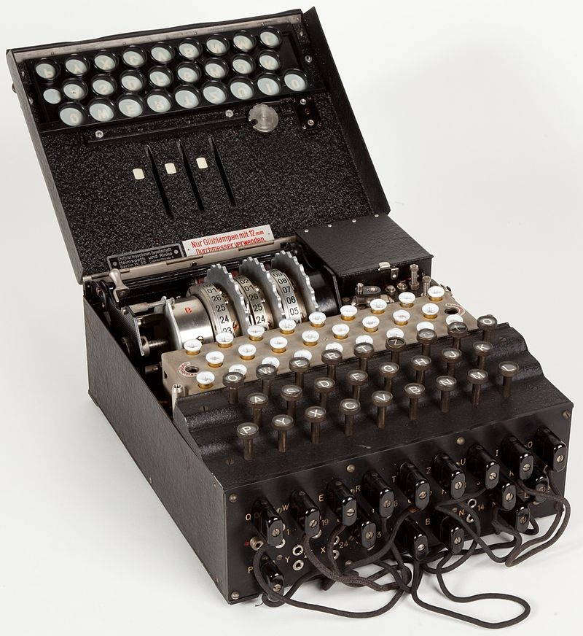
History of Cryptography
enigma
Never encodes a letter to itself
one of the weaknesses exploited
https://en.wikipedia.org/wiki/Enigma_machine#Breaking_Enigma

Slide 16
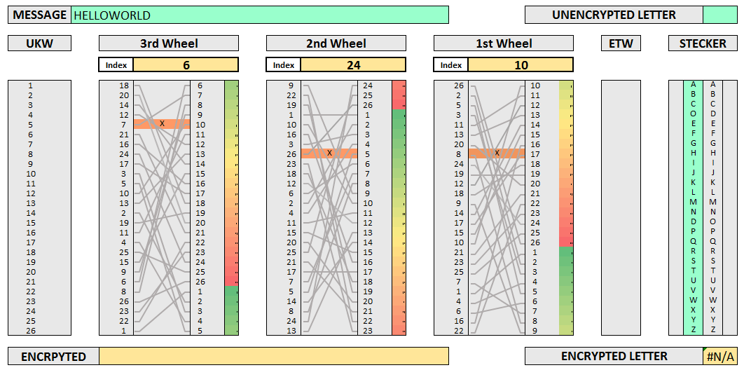
History of Cryptography
enigma
Example with 3 rotors
and one plug
Cleartext: HELLOWORLD
Key:
Wheel I Index10
Wheel II Index24
Wheel IV Index6
Stecker D-O
Ciphertext: UINTTPGASJ
Repeats after 16100 steps
http://swimmingthestyx.com/?p=368
Random seed
Pseudo random
generator

Slide 17
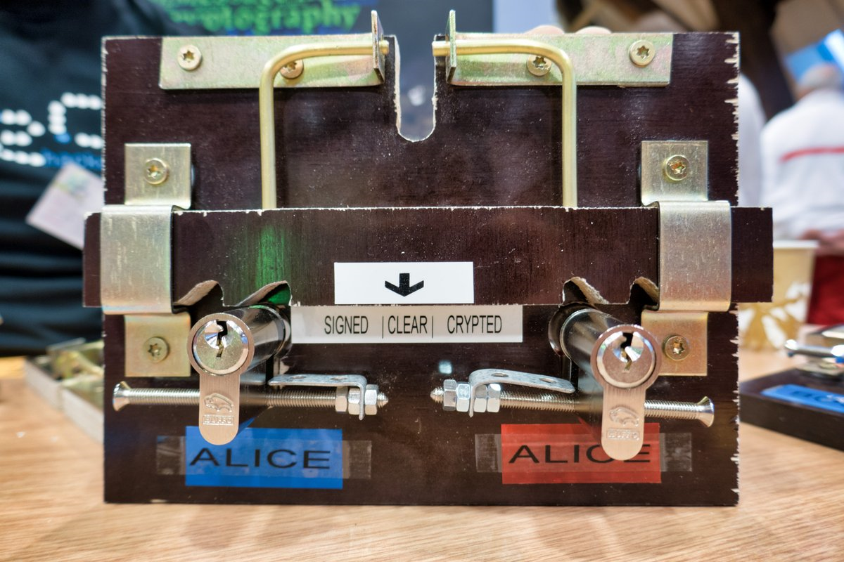
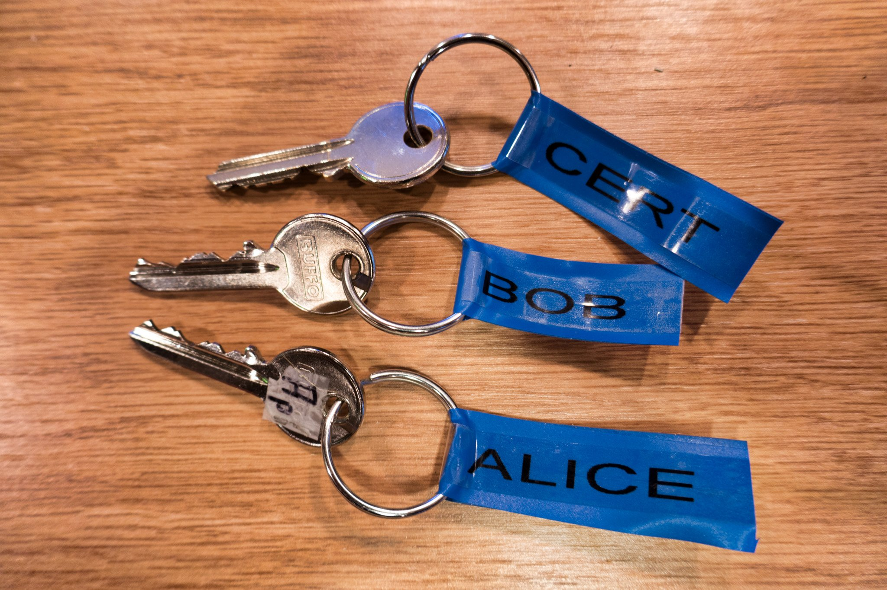
History of Cryptography
Public/Secret Keys
Today
Lots of maths, let's use simple locks
One way
function
Public key
Private key
(secret)
Algorithm: the one way lock
Key generation
Encrypting
Decrypting
Signing in a box
Certificates and chains
Keystore

Slide 18
Part 2
Modern Cryptography
Overview of Algorithms
by
Georges Kesseler

Slide 19
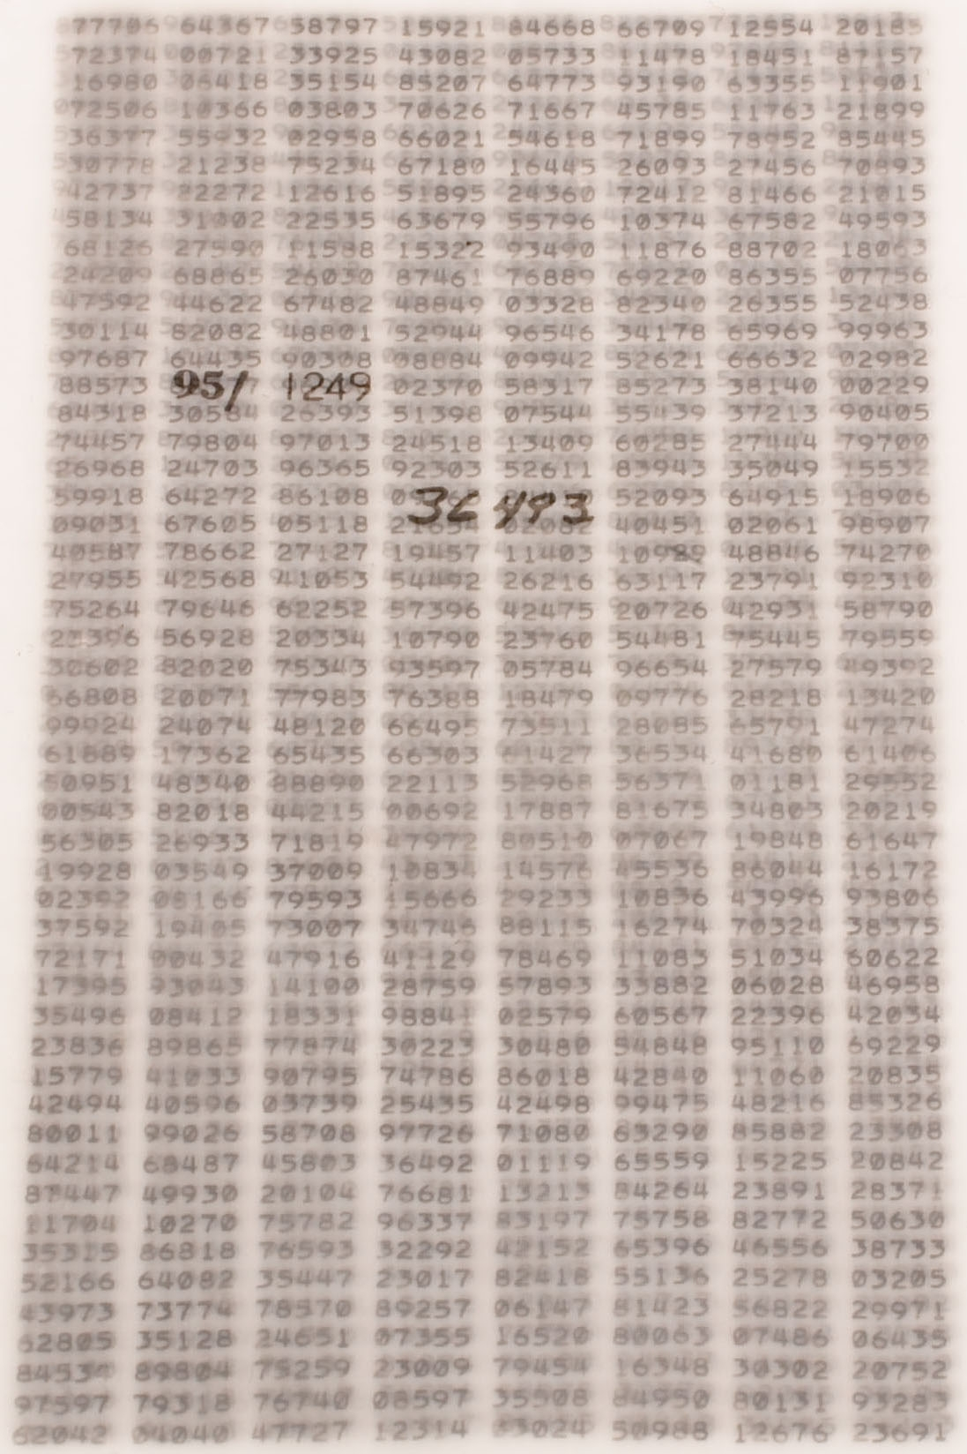
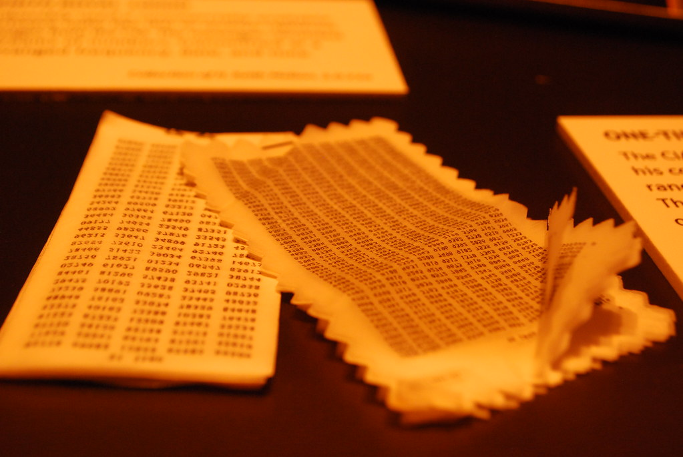
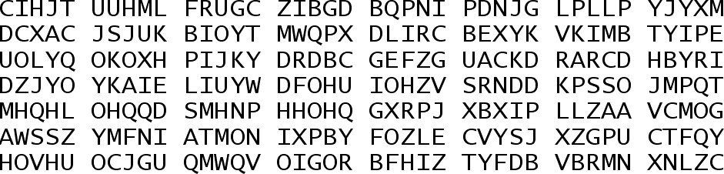
Modern Cryptography
One time pad
A really really long key
‘Solution’ to the short password problem
"CIA One time pads" by OnceAndFutureLaura is marked with CC BY-NC-SA 2.0.

Slide 20
Modern Cryptography
Binary Encryption
it's XOR all the way
Numbers instead of letters
XOR
2 values: 0 and 1
For the cleartext
And for the key
=> 4 possibilities:
Cleartext | Key | Cyphertext
0 | 0 | 0
0 | 1 | 1
1 | 0 | 1
1 | 1 | 0

Slide 21
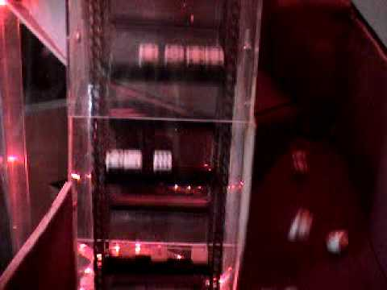
Modern Cryptography
Random numbers
A one time pad in binary
10100011101001010101010110101010111111001110101011001000101010101010010101010101001010101010011000110000010101110101101001010
true randomness
difficult to generate by computer. Roll the dice:
Pseudo random numbers
Computer generated
Can have flaws: need good algorithm

Slide 22

Modern Cryptography
Symmetric Cyphers
One key, fast
Historic algorithms
Caesar cypher
Viginère cypher
Modern algorithms
Stream cyphers (RC4)
Block cyphers (DES, AES)

Slide 23
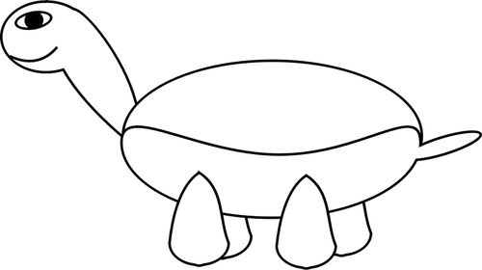
Modern Cryptography
Asymmetric Cyphers
Two keys, slow
RSA (Rivest, Shamir, Adleman)
Elliptic Curve
Examples of usage

Slide 24
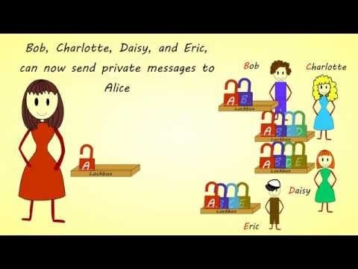

Modern Cryptography
RSA
Rivest, Shamir, Adleman
Uses prime numbers
Easy to calculate
Difficult to reverse
If you lose your keystore,
consider the keys leaked
https://www.youtube.com/watch?v=E5FEqGYLL0o

Slide 25
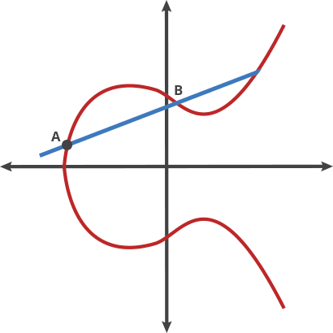
Modern Cryptography
Elliptic Curves How many billard hits did he do?
This is an elliptic curve
Nice formula: y²=x³+ax+b
« Adding » points n times
It is impossible to find how often The point was added
More deeper infos: https://curves.xargs.org/
Here we use ‘3’ to find the public key E from A
the private key is 3
The public key is A and E
It is impossible to find 3 just knowing A and E

Slide 26
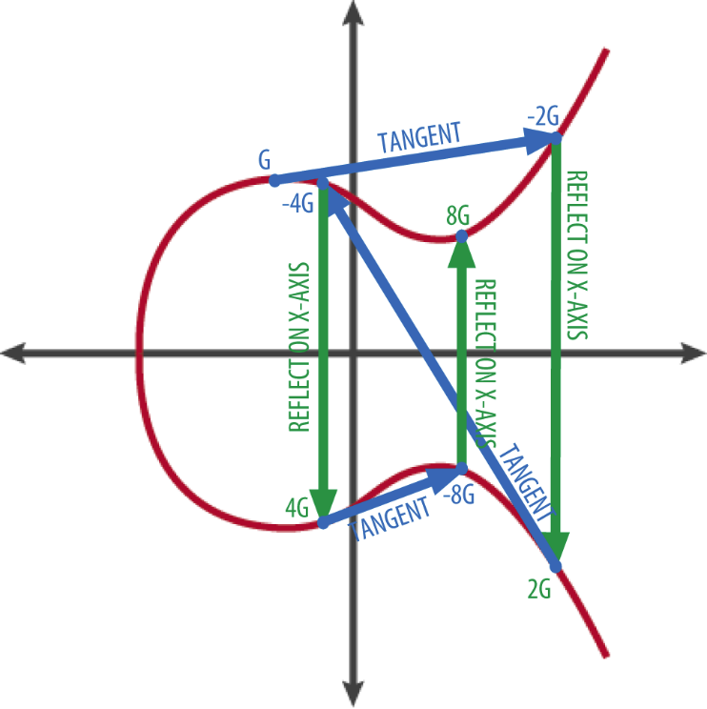
Modern Cryptography
Elliptic Curves How many billard hits did he do?
Start with the ‘public point’ G
Point-add it to itself n times
Possible to shorten:
8*G = 4*G + 4*G
4*G = G+G + G+G
Doing G+G 3 times gives 8*G
This is the same as G+G+G+G
+G+G+G+G
So the secret key is 8

Slide 27
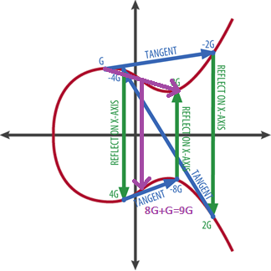
Modern Cryptography
Elliptic Curves How many billard hits did he do?
What if secret key = 9 ?
9*G = 8*G + G
Just add once G
So 9*G is fast
Efficient algorithm
9G=8G+G

Slide 28
Modern Cryptography
Examples of cryptography usage
Pretty Good Privacy (PGP)
Web browsers (SSL)
Luxtrust
Secure Shell (ssh)
Credit Cards
Passports
VPN
EU Vaccination Certificate
Ransomware

Slide 29
Modern Cryptography
Hash Algorithms
Verifying and Fast signing
Short representation of document. Unique
Asymetric cyphers are slow: signing will take very long
=> sign the hash
Fast hashing for integrity and signing
Slow hashing for saving passwords
Blockchain "proof of work" uses hashing

Slide 30
Cleartext
Plaintext
Cyphertext
Encrypted data
Password
Passphrase
Public key
Private key (secret)
Security by obscurity
Dictionary attack
Bruteforce attack
Algorithm
Substitution cypher
Random seed
Pseudo random number generator
Padding
One way function
Hash
...
Conclusion
What did we learn
Symmetric and Asymetric encryption
Safekeeping of your secrets
Public Key Infrastructure

Slide 31
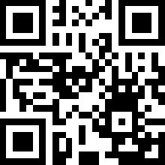
Thanks & Contact
Syn2cat (material & course concept)
Luca (testing)
Georges.Kesseler@dlh.lu
Youtube: https://www.youtube.com/watch?v=iW8DV2UvkAg
Github: https://github.com/syn2cat/CryptoMessageInABottle/

Slide 32
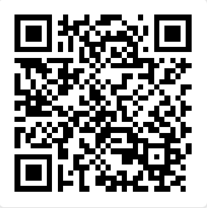
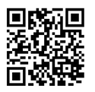
Please give us feedback about the course

